Slide 1


Unit 3
What kind of information can the HHFA provide?
Notes:
Welcome to Unit 3 of Module 1.

Slide 2
By the end of this unit, you will be able to:
explain what kind of information an HHFA can and
cannot provide
Notes:
By the end of this unit, you will be able to explain what kind of information an HHFA can and cannot provide.

Slide 3



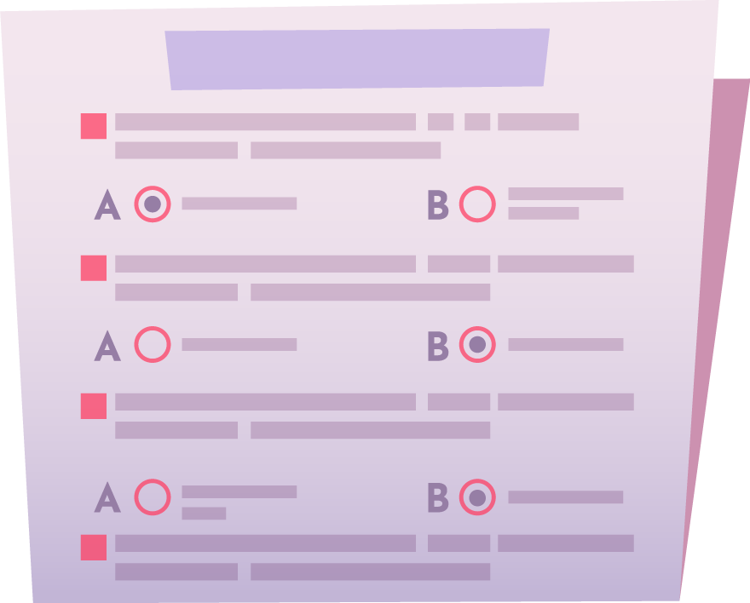
HHFA Indicators
HHFA questions
data
analysis
HHFA indicators
Notes:
The HHFA questions and questionnaires enable data to be collected. These data are then analyzed to calculate the HHFA indicators.

Slide 4

HHFA Indicators
Most HHFA indicators are percentages:
% facilities offering a particular service
% facilities with a particular item in place
Notes:
Most of the HHFA indicators are percentages. They are usually expressed as:
the percentage of facilities offering a particular service; or
the percentage of facilities with a particular item in place.

Slide 5
HHFA Indices
%
%
index
%
Notes:
A selected group of indicators can also be combined to create an index. An index is used to summarize and communicate information.

Slide 6
What kind of information CAN the HHFA provide?
Examples of indicators are:
Availability
% facilities offering malaria services
Readiness: General
% facilities with electricity
Readiness:
Service - specific
% facilities offering malaria services with 1st line antimalarials in stock
Quality of Care
% ANC clients that received screening for syphilis during ANC
Management
and Finance
% facilities with a management committee that met in the last 3 months
Notes:
Let’s look at some examples of the kinds of indicators that the HHFA can provide, based on the HHFA modules.
First, Availability – the services that are available in health facilities. For example:
the percentage of facilities offering malaria services.
Readiness – the key resources that are in place to deliver the service. For example:
the percentage of facilities with electricity;
the percentage of facilities offering malaria services with first line antimalarials in stock.
Readiness is divided into general and service-specific readiness:
general readiness looks at the overall readiness of the facility to provide basic services;
service-specific readiness looks at whether each specific service has the key items it needs to deliver this service.
In the indicator inventory, and also in the outputs of the analysis platform, the readiness indicators are organized into general readiness and service-specific readiness.
Quality of care looks at the extent to which required standards are followed in the patient care process. For example:
the percentage of ANC clients that received screening for syphilis during ANC.
Finally, Management and finance looks at the various management systems in place in the facilities. For example:
the percentage of facilities with a management committee that met within the past 3 months.

Slide 7



What kind of information can the HHFA NOT provide?
HHFA can
HHFA cannot
Notes:
It is important to understand what information the HHFA can and cannot provide. Senior decision-makers and funders need to have a sound awareness of this, to ensure that the HHFA will meet their expectations.

Slide 8

What kind of information can the HHFA provide?
system-level indicators
facility-level indicators
The HHFA is designed to provide a snapshot of the functioning of the overall service delivery system, based on defined conditions.
Notes:
Let’s start with system-level versus facility level indicators.
The HHFA is designed to provide a snapshot of the functioning of the overall service delivery system, based on defined conditions that exist within health facilities – hence the indicators talk about “percentage of facilities”.

Slide 9


What kind of information can the HHFA NOT provide?
The HHFA indicators are not designed to represent individual facilities or provide comparisons among individual health facilities.
Notes:
The HHFA indicators are not designed to represent individual facilities or provide comparisons among individual health facilities.
However, data from individual facilities can be extracted for further analysis if a census of all facilities was conducted.

Slide 10
What information can the HHFA NOT provide?
HHFA does NOT gather data on:
HHFA CANNOT provide information on:
numbers of people using the services
service utilization
illnesses they have
disease incidence or prevalence
interventions they receive
coverage of interventions
outcomes of interventions
they received
treatment outcomes
Notes:
The HHFA does not collect data on the numbers of people using the services, on the illnesses they have, the interventions they receive, or on the outcomes of the interventions they receive.
Therefore, the HHFA cannot provide information on:
service utilization;
disease incidence or prevalence;
coverage of interventions; or
treatment outcomes.

Slide 11
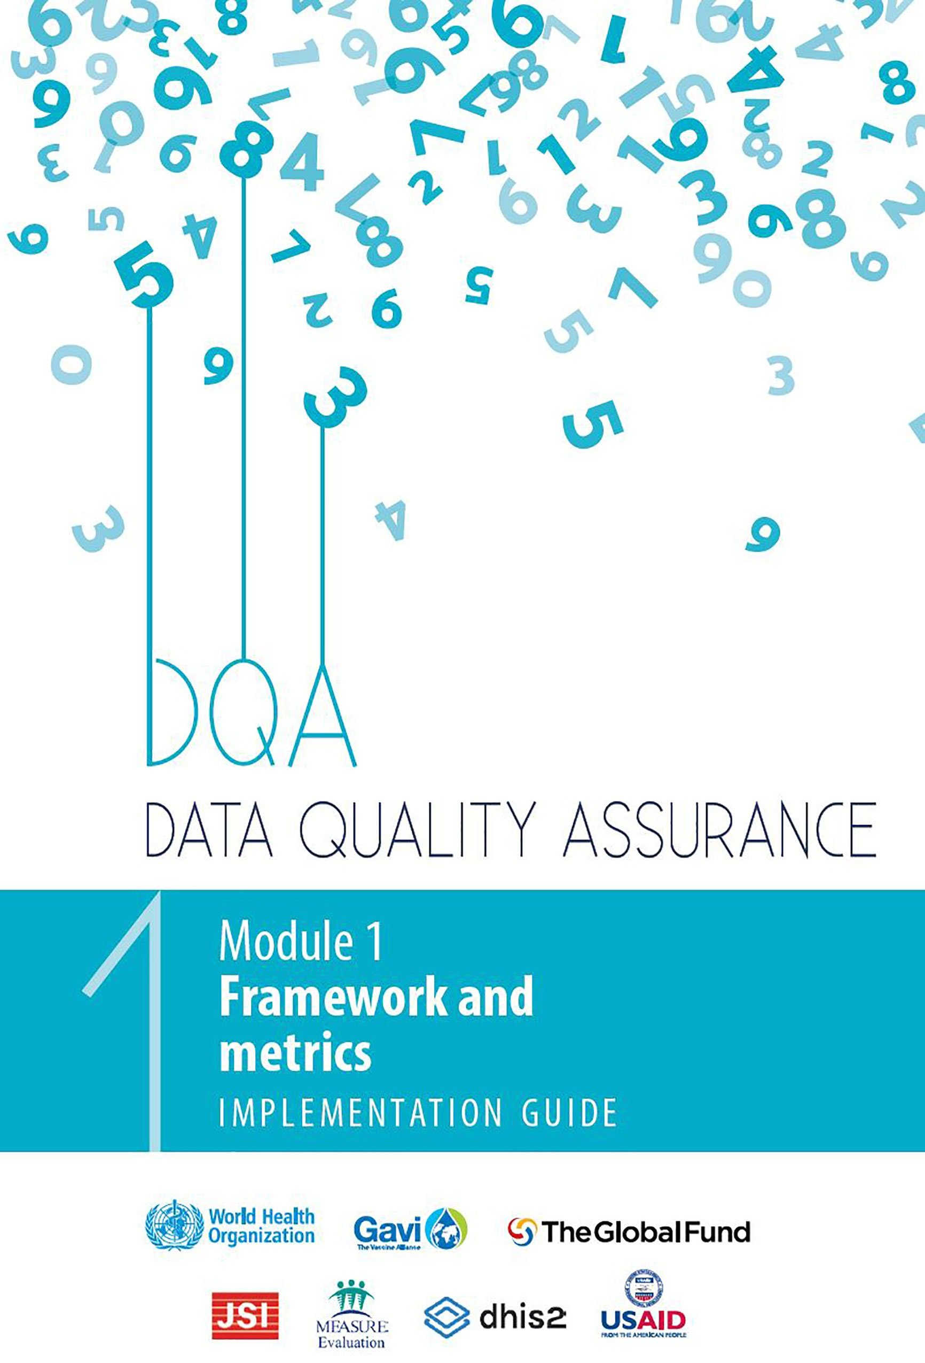
What information can the HHFA NOT provide?
The HHFA does NOT collect information on the quality of routine health facility data.
DQA toolkit
Notes:
The HHFA does not collect information on the quality of routine facility data.
A separate set of WHO tools – the data quality assurance, or DQA, toolkit – is available for this purpose.

Slide 12
You have now completed Unit 3.
Now try the end of module quiz.
Notes:
You have now completed Unit 3.
Now try the end of module quiz.

